Slide 1


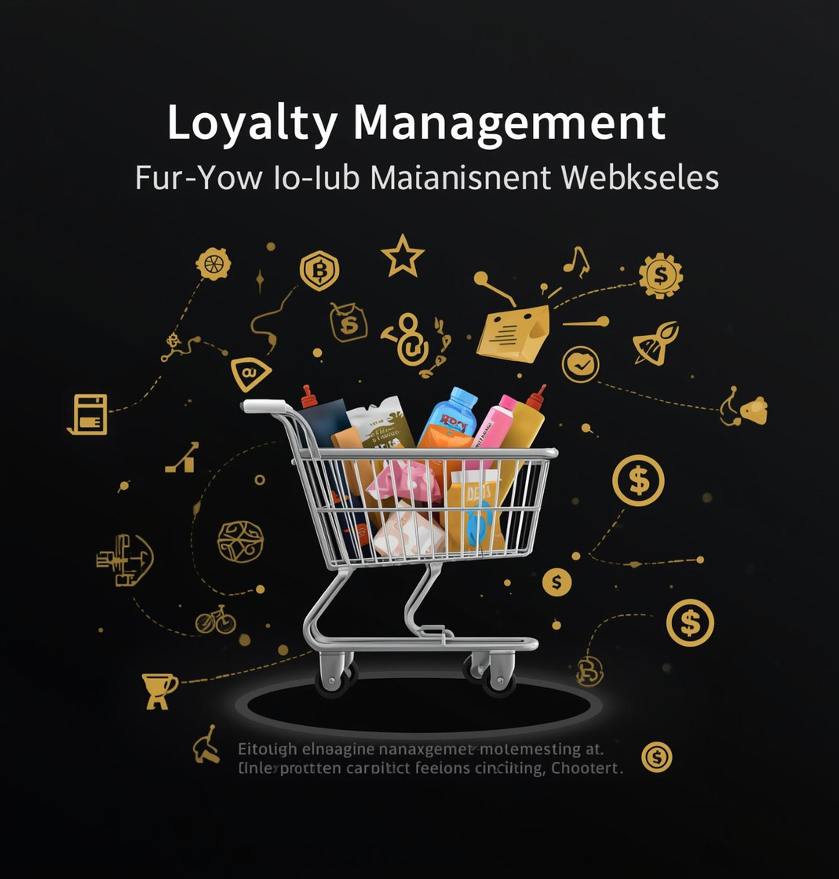
Loyalty Solutions Inc.
PRESENTED TO
PRESENTED BY
SmartBridge Team
G. Ganesh
Customer 360 Loyalty Intiative & Trust
Optimizing Customer Retention in E-Commerce

Slide 2




Customer Retention
Addressing customer retention is crucial for e-commerce success, as businesses face challenges in maintaining loyal customers and enhancing engagement strategies.

Slide 3

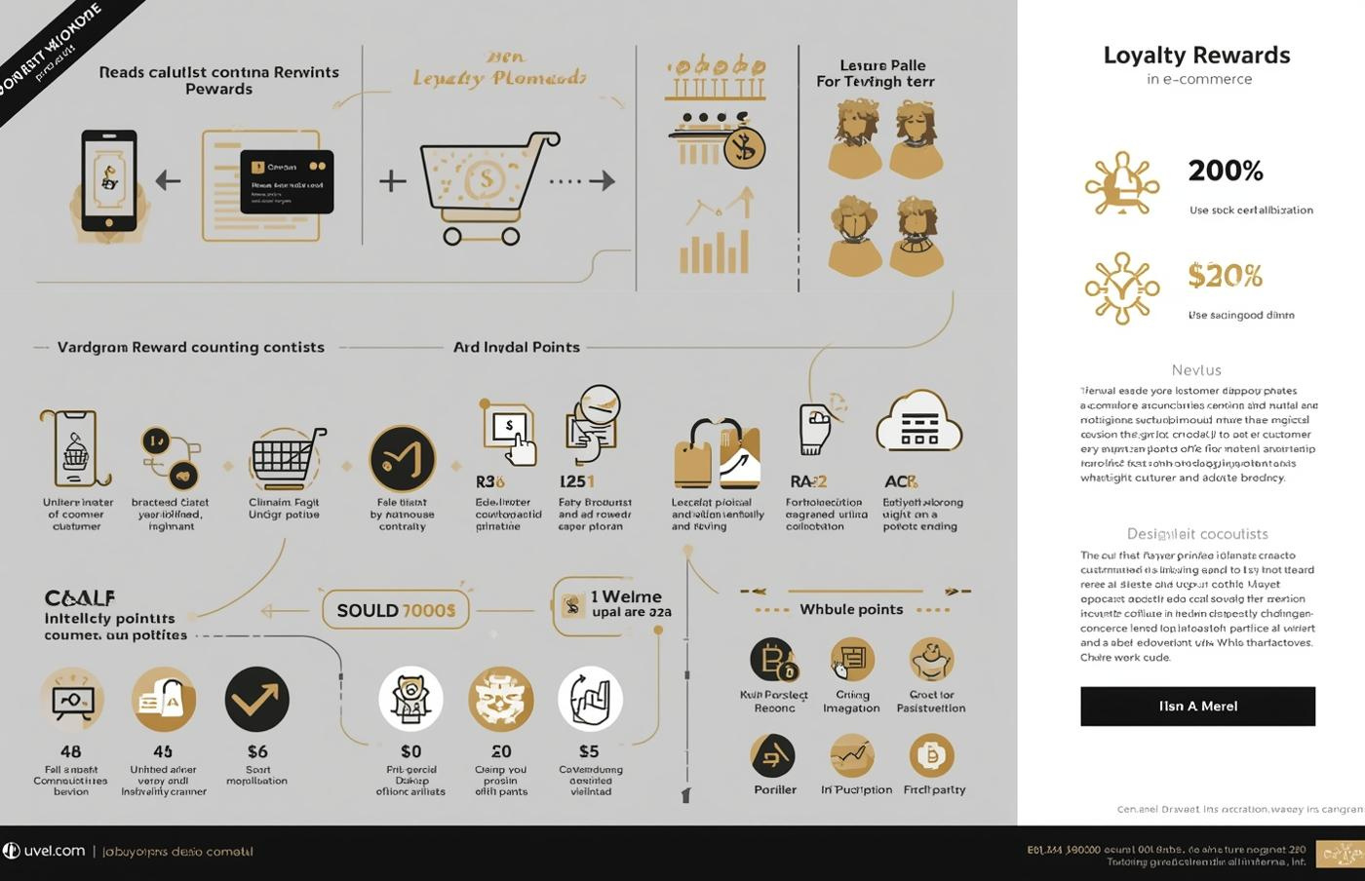

Key goals for Customer Loyalty Management System
Automate the accumulation of loyalty points
Simplify the reward redemption process
Streamline manager approval workflows
Provide comprehensive reports and dashboards
Objectives of the Project

Slide 4



Identifying key issues affecting engagement
Lack of visibility in loyalty rewards
Complicated manual processes for users
Low customer engagement in programs
Difficulty in redeeming loyalty points
Insufficient manager oversight and control
Challenges in Loyalty Programs

Slide 5

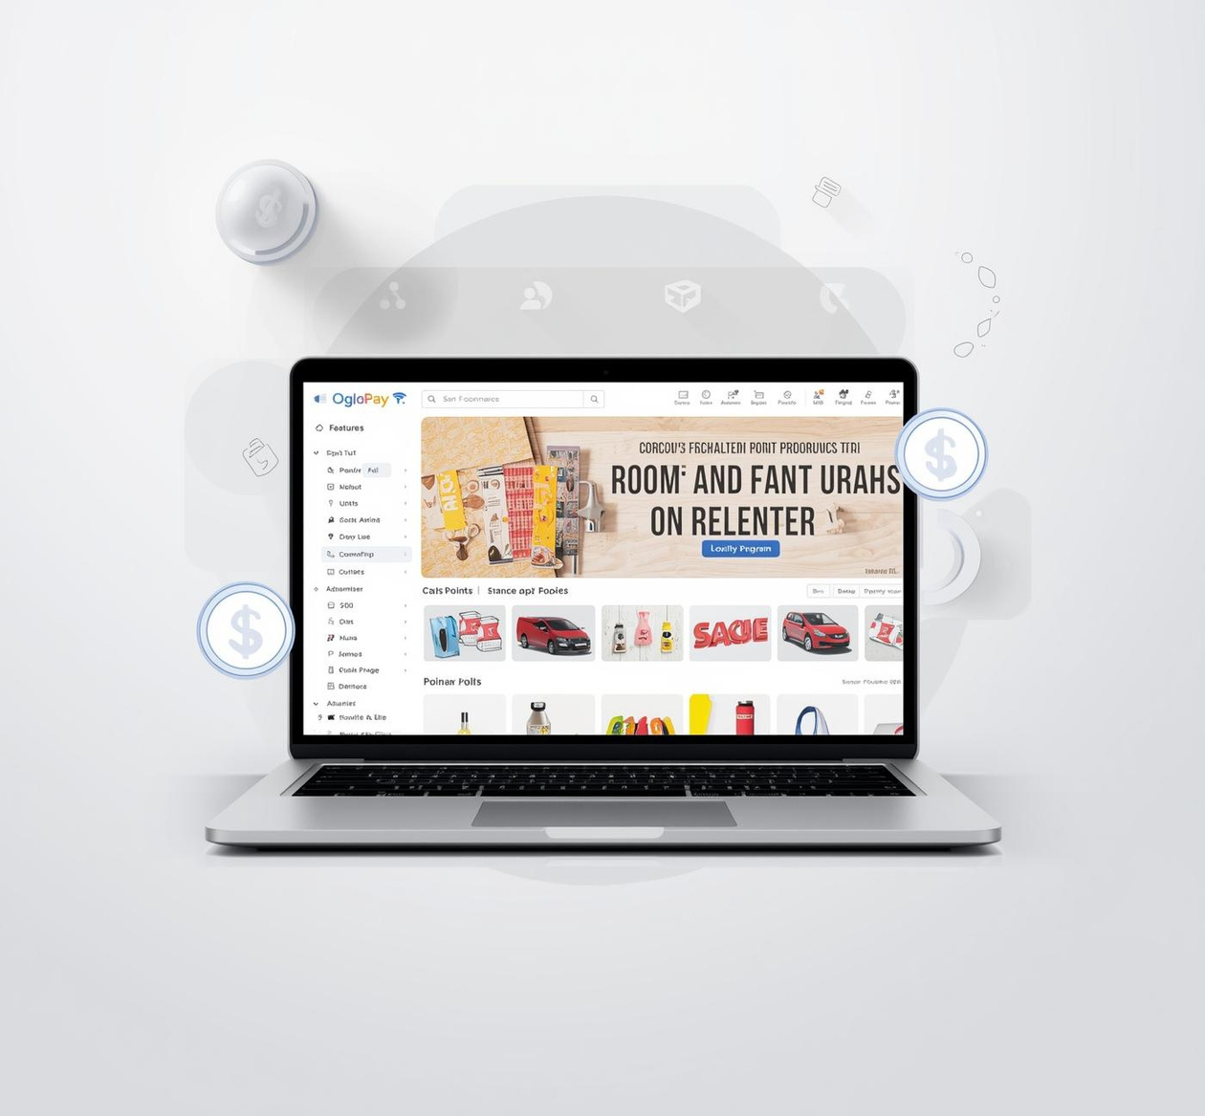

Proposed Solutions
LOYALTY PROGRAM AUTOMATION
Streamline operations with automated loyalty points and reward redemptions.
ENHANCED CUSTOMER ENGAGEMENT
Improve user experience with transparent and engaging loyalty features.
COMPREHENSIVE REPORTING TOOLS
Real-time dashboards and reports for informed decision-making and insights.

Slide 6
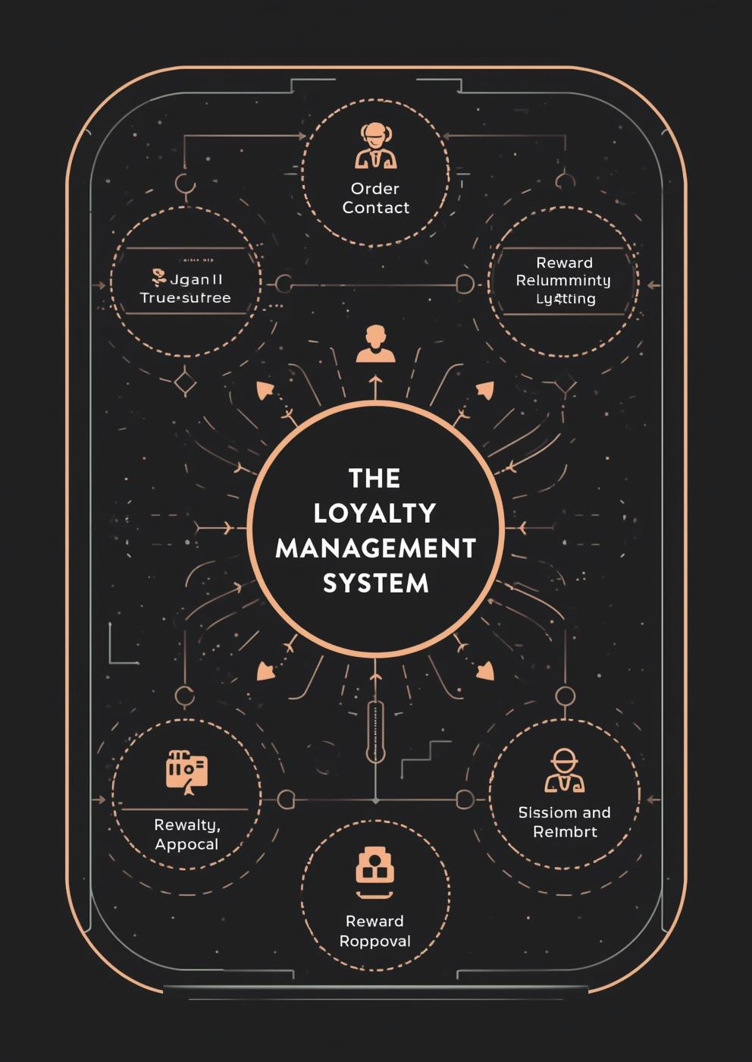

System Architecture
This diagram illustrates the relationships among Salesforce objects, showcasing how they interact to support the Loyalty Management System for e-commerce.

Slide 7

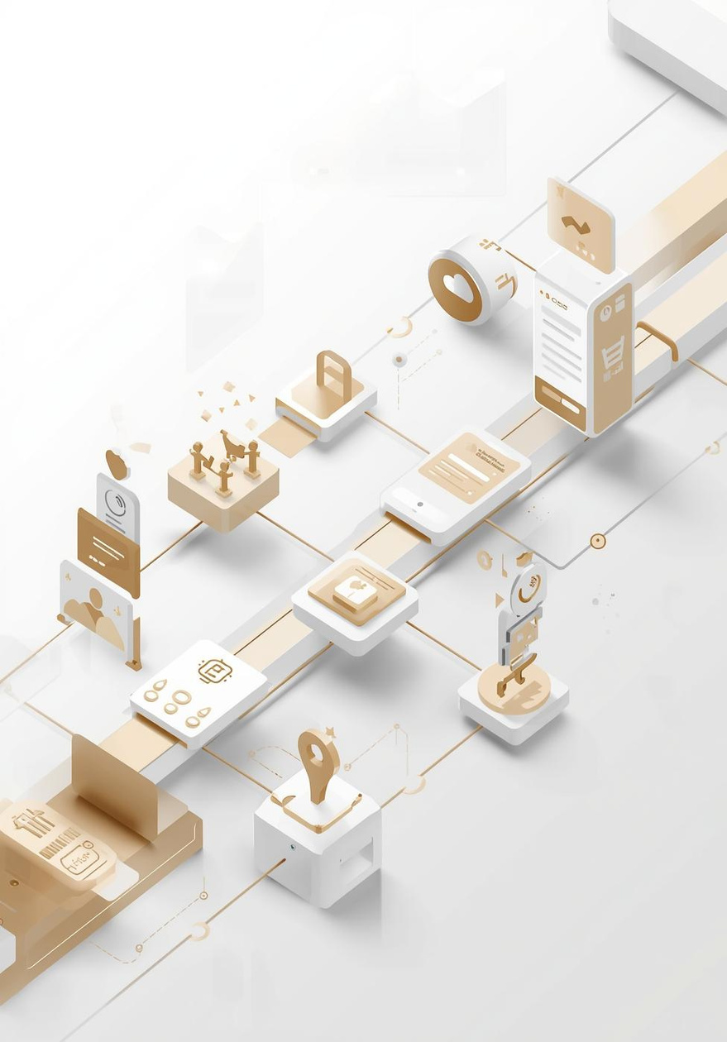


Key Features of Loyalty Program
Essential functions for enhanced customer experience
First Set of Features
Second Set of Features
Add loyalty points automatically for purchases
Easy workflow for claiming rewards
Streamlined redemption approval process
Comprehensive reports and dashboards available
Detailed error logging for troubleshooting
User-friendly interface for managers and customers

Slide 8


Implementation Steps
Key phases of project development
Custom Objects
Approval Process
Apex Trigger
Reports/Dashboards
Define and create necessary objects
Establish workflow for approvals
Develop triggers for automation
Generate insights through reporting tools

Slide 9




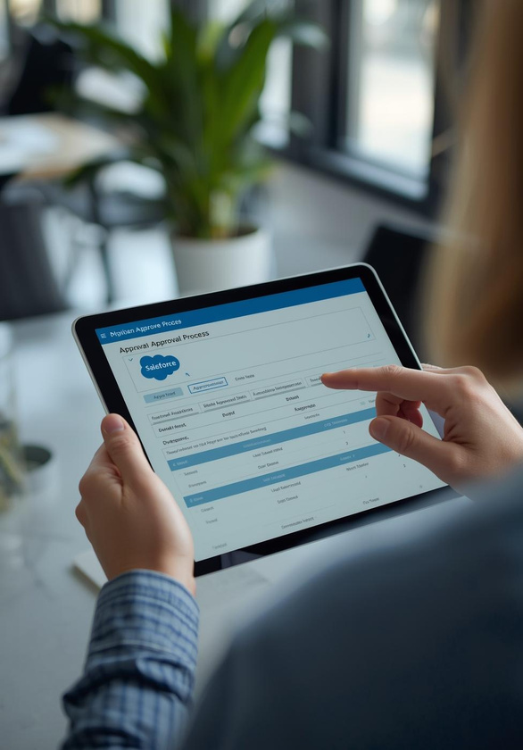

Professional Interaction in Salesforce Environment

Slide 10



Highlighting the benefits of automation and transparency
Streamlined processes enhance operational efficiency
Automated loyalty points boost customer engagement
Transparent systems foster customer trust and satisfaction
Improved manager control over reward redemptions
Comprehensive reports aid in strategic decision-making
Key Advantages of Our Solution

Slide 11

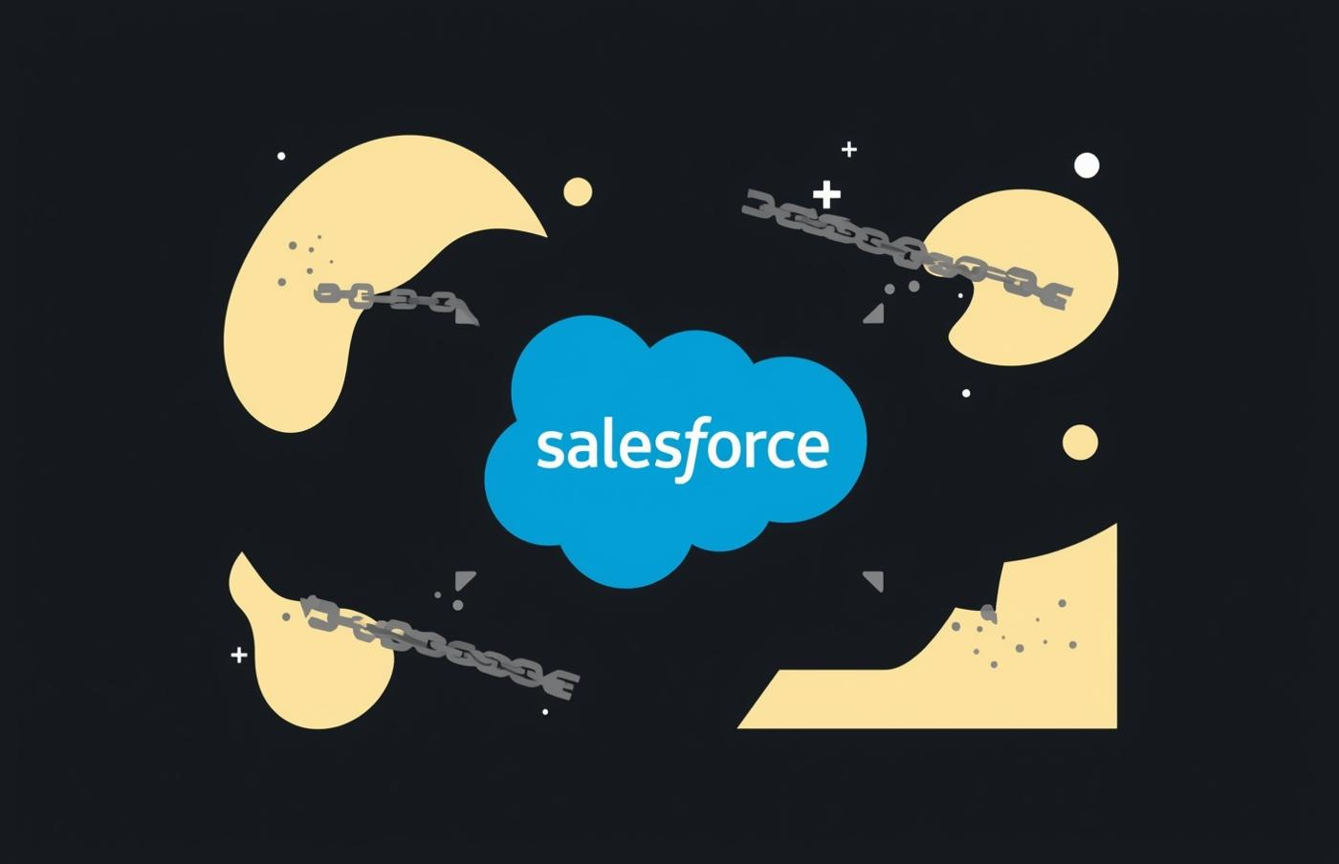

Key challenges to consider during implementation
Dependency on Salesforce licensing requirements
Complexity of initial setup and configuration
Restrictions on dashboard folder access
Potential learning curve for users
Integration challenges with existing systems
Limitations of the Proposed Solution

Slide 12
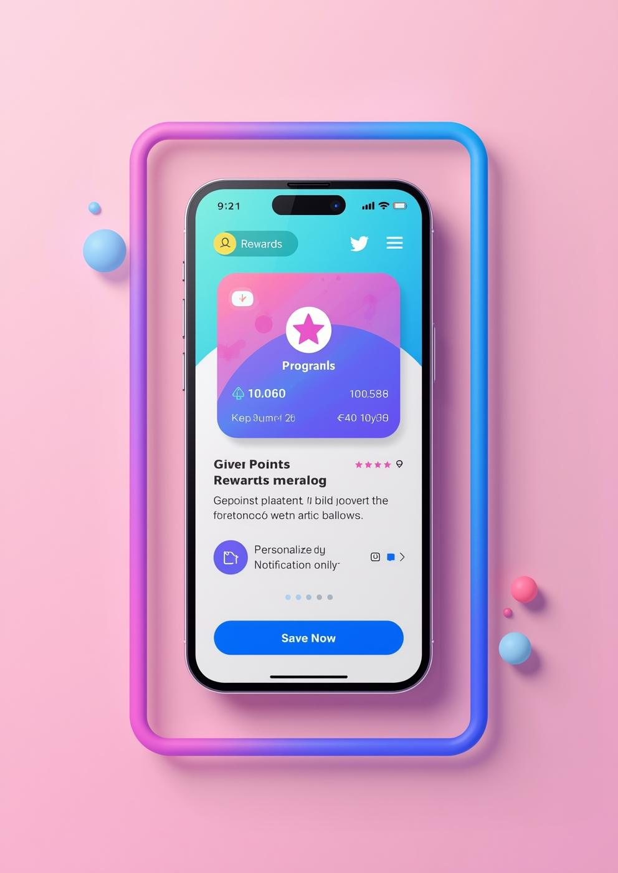
Future Enhancements
This project aims to enhance customer engagement through AI-driven recommendations and seamless mobile app integration for better user experience.

